Slide 1
Non Adaptive Partial Image Encryption
BRSNC - UG
Department of computer science
Anupunja Dasgupta, Soumarkya Ghosh and
Subhojit Ghosh
Under supervision of Dr. Sukalyan Som

Slide 2
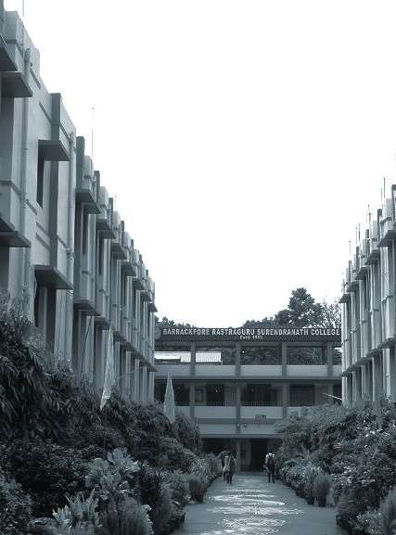
BARRACKPORE RASTRAGURU SURENDRANATH COLLEGE
Department of Computer Science
Presentation for CMSADSE06P on
Non adaptive Partial Image encryption
Supervised by Dr. Sukalyan Som

Slide 3

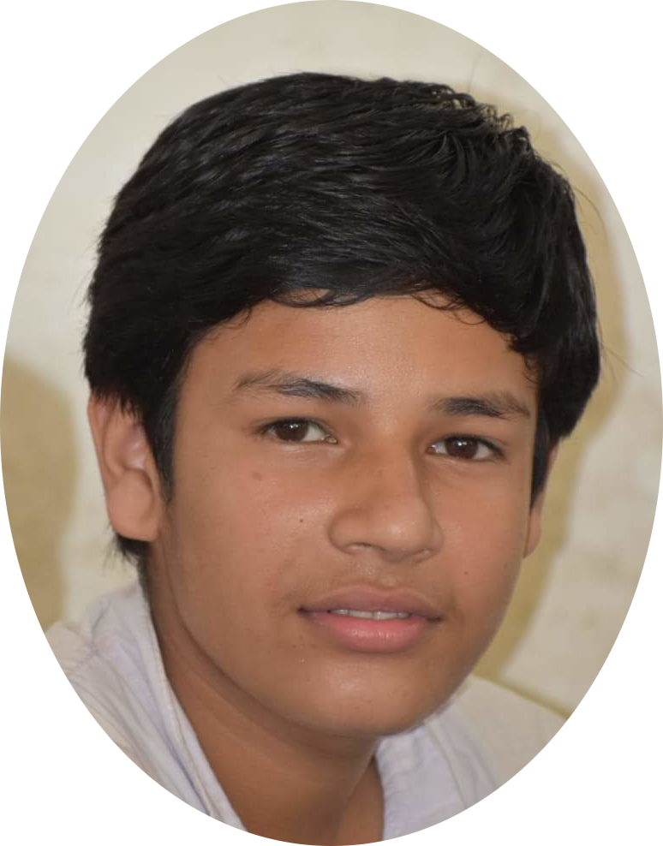

ANUPUNJA DASGUPTA
Roll: 6231107 06591
Registration No. 1032011400066
SOUMARKYA GHOSH
Roll: 6231107 06585
Registration No. 1032011400070
SUBHOJIT GHOSH
Roll: 6221103 06589
Registration No. 1032011600046

Slide 4
Table of Contents
1
2
Introduction
Methodology
5
4
3
Conclusions
Analysis
Visualization

Slide 5
Introduction

Slide 6
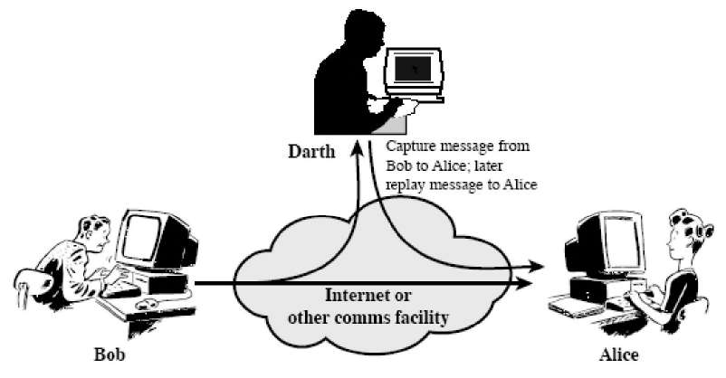
Why Encryption is needed?
Encryption can protect us from unauthorised access of our data
Encryption increases the integrity of our data
Encryption is cheap to implement
Encryption increases the consumer’s trust

Slide 7
Objective
To develop,
A Non- Adaptive Partial Image Encryption schemes based on chaos.
Techniques to evaluate the quality of encrypted image.

Slide 8
Methodology

Slide 9
Flow Chart Illustration
Start
Original Image
Pseudo Random Matrix
Bitplane Images
Yes
Signiﬁcant
?
No
Unencrypted Image
XOR
Encrypted Image
Combine
Cipher Image
Stop

Slide 10
How does this works ?
An original image is ﬁrst decomposed into its 8 binary bit planes among which the signiﬁcant ones are non-adaptively determined.
The signiﬁcant bitplanes are encrypted with the key stream generated by a ‘Pseudo Random Binary Bit Generator’ and then combined with the unencrypted ones to form the cipher image.
Performance of the technique is veriﬁed by tests based on image statistics, key sensitivity and impermeability of cipher image.

Slide 11


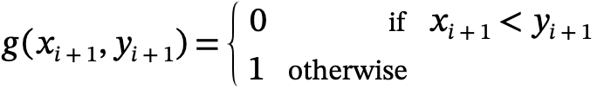
Pseudo Random Binary Number Generator
The chaos based pseudo random binary number generator generate a single random bit by using previous random generated bit.
By using the system parameter ⍺ and initial values of x_{i} and y_{i} we determine the next value of the sequence as –
The bit sequence g( x_{i+1} + y_{i+1}) is generated as follows –

Slide 12
Method of Encryption
Decompose the original image into bitplane images
Determine the significant bitplane
For each significant bitplane
Generate an pseudo random binary matrix using logistic map
Perform XOR operation with significant bitplane
Combine the cipher bitplanes and unencrypted bitplanes to generate the cipher image.

Slide 13
Method of Decryption(Theoritical)
Get the key values
Decompose the cipher image into bitplane images
Determine the significant bitplanes
For each significant bitplane
Perform XOR operation on encrypted bitplanes with previously generated key
Combine all the bitplanes to decrypt the cipher image.

Slide 14
Visualization

Slide 15

Test Image
Consider the plain image to be original (x,y) of size M ✕ N where x = 0,1,2, …, M - 1, And y = 0,1,2, …, N-1.
Test Image Name: “Lena”
Size: 512 x 512
Type: Miscellaneous, Grayscale
Format: Uint8

Slide 16
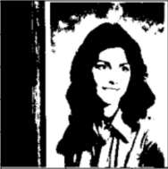
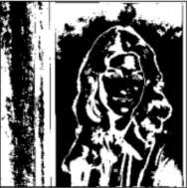
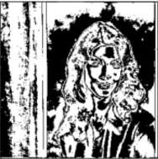
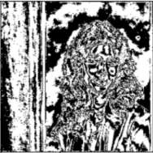
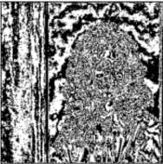
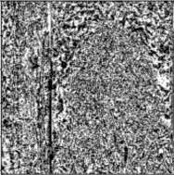
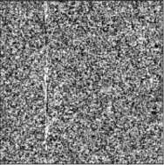
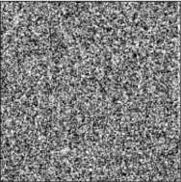
8 Bitplane Decomposition
Each pixel value P(x,y) in l_{original} (x,y) is decomposed into its corresponding 8 bit binary equivalent and thus 8- planes BP(x,y)∀i = 1,2,...,8 are formed.
Bitplane Images
Original Image

Slide 17
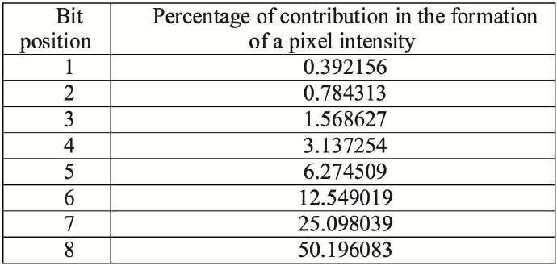
Signiﬁcant Bitplanes Determination
Signiﬁcant bit planes are determined by the level α critical region from the H₀: i^{th} bit-planes signiﬁcant against the alternative hypothesis H₁: i^{th} bit-planes not signiﬁcant where the test statistics is the percentage contribution of a bit plane in formation of a pixel.
95%

Slide 18
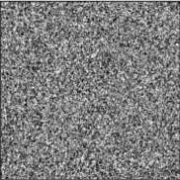
Cipher Bitplane Generation
The signiﬁcant bit planes, determined by α% (0.05) level of signiﬁcance, are ciphered as CBP_{j}= BP_{j} ⊕ K_{j} ∀ j= 5,...,8.
Bitplane
Random Matrix
Cipher BP
+
+
+
+

Slide 19
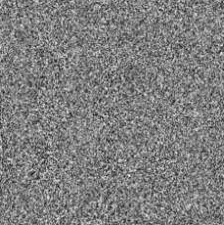
Cipher Image Composition
The cipher bit planes CBP_{j} and the unencrypted bit plane BP_{j} are combined together to form cipher image as C_{i}(x,y) = CBP_{j} + BP_{k}∀i = 1,2...,8, j = 5,..8 and k = 1,...4 where + is used for combining process.
Bitplane Images
Cipher Image

Slide 20
Analysis

Slide 21

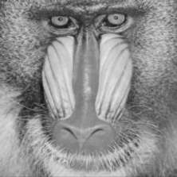

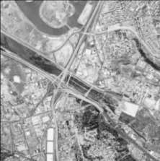
Test Images
Name: Lena
Size: 512 x 512
Type: Miscellaneous, Grayscale
Format: Uint8
Name: Baboon
Size: 512 x 512
Type: Miscellaneous, Grayscale
Format: Uint8
Name: Pappers
Size: 512 x 512
Type: Miscellaneous, Grayscale
Format: Uint8
Name: Map
Size: 512 x 512
Type: Aerials, Grayscale
Format: Uint8

Slide 22
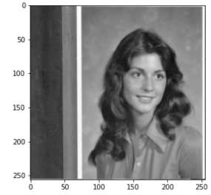
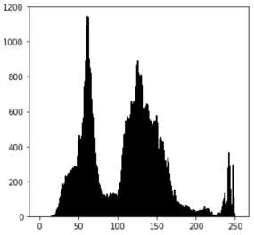
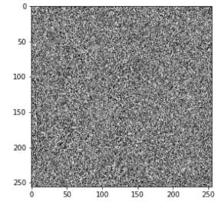
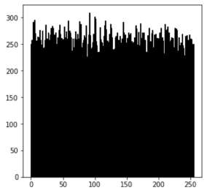
Histogram Analysis
An image histogram demonstrates how pixels in an image are distributed by graphing the number of pixels at intensity level.
In order to have a perfectly ciphered image the histogram of the image must exhibit uniformity of distribution of pixels against the intensity values.
Original
Cipher

Slide 23
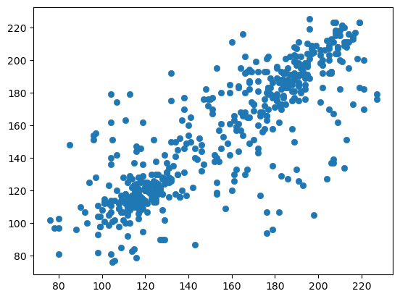
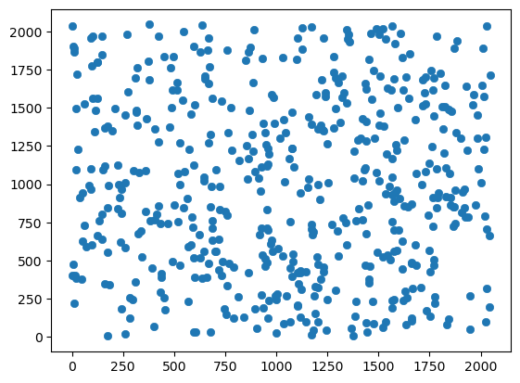
Scatter Plot Analysis
Original
Cipher
A scatter plot uses dots to represent values for two different numeric variables. The position of each dot on the horizontal and vertical axis indicates values for an individual data point.
Scatter plot of original image residing in a particular region. But, in case of cipher image, the dots are distributed properly.

Slide 24
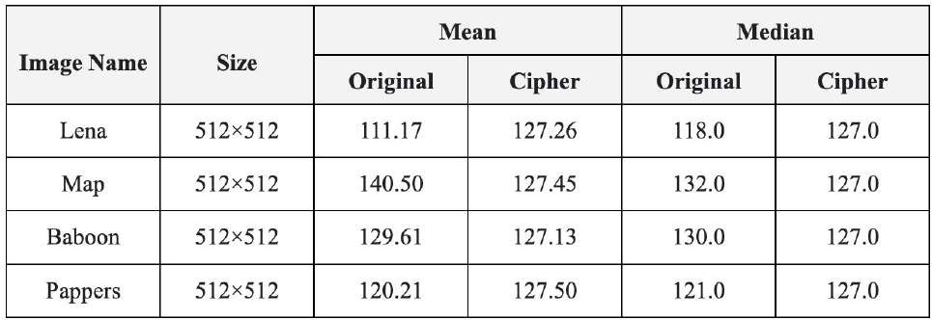
Measures of Central Tendency
Measures of Central Tendency have been used as a measure of homogeneity.
The measures in Cipher Images are uniform which shows that cipher images have uniform mean, median pixel intensities.

Slide 25
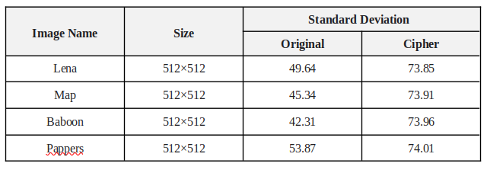
Measures of Dispersion
It is a measure of spread of data about the mean.
Standard deviation (SD) is the most commonly used measure of dispersion.

Slide 26


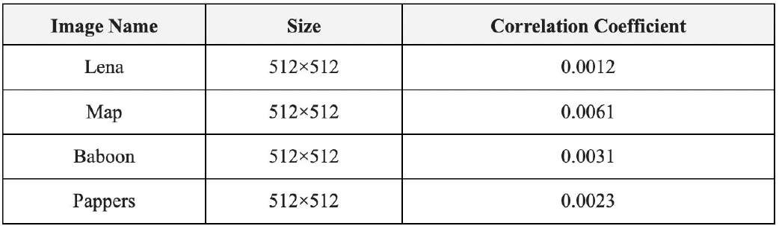
Correlation Coefﬁcient Analysis
In most of the plain images, there exists high correlation among adjacent pixels whereas poor correlation between the neighboring pixels of corresponding cipher image is observed. The formula used to get correlation coefﬁcient is –

Slide 27
Conclusions

Slide 28
Concluding Remarks
Proposed scheme encrypts an image with efﬁciency which ensures the users privacy on their data.
Pseudo random logistic map provide a superior security.
A non-adaptive partial image encryption method is proposed, which saves 30% of computation by determining signiﬁcant bit positions.
A median ﬁlter degradation model used, which can reduce noise up to 95% to restore the original image.

Slide 29
Conclusion
Image plays an important role in lives and they are used in many applications in our day to day lives. Therefore it is necessary to affirm the integrity and confidentiality of the digital image that is being transmitted.
These encryption methods are studied and analyzed well to promote the performance of encryption methods. Each technique is unique in its own way and this makes it suitable for its many applications. Everyday new techniques are evolving hence fast and secure conventional encryption techniques work with high security rate.
Our model is based on grayscale image processing, but it can work on color images as well (where color images have 3 channels) with efficiency. The standard tricolor images produced by the SDSS are very good images. A picture that is processed to show faint asteroids may be useless to study the bright core of a galaxy in the same field.

Slide 30
Future Scope
At the end of the day we need to protect our data. Increasingly, encryption is being seen as the best way to ensure that data is protected, but the ever growing use of encryption creates a management challenge.
The challenge, however, doesn’t need to be daunting. Implementing a flexible and extensible solution that automates many of the time-consuming and error-prone key management tasks in an automated enterprise-wide manner is rapidly becoming a priority for many organizations.
A function ‘NumberOfSignificantBitplane()’ can be designed in such a way to automate the number of key significant bitplane images that can be found, to focus on further processing.
(𝑖𝑛𝑡) ← 𝑁𝑢𝑚𝑏𝑒𝑟𝑂𝑓𝑆𝑖𝑔𝑛𝑖𝑓𝑖𝑐𝑎𝑛𝑡𝐵𝑖𝑡𝑝𝑙𝑎𝑛𝑒 ( 𝐵𝑖𝑡𝑝𝑙𝑎𝑛𝑒𝐼𝑚𝑎𝑔𝑒𝑠):
𝑠𝐵𝑖𝑡 = 𝑖𝑛𝑡 ( 𝑛𝑢𝑚𝑏𝑒𝑟 𝑜𝑓 𝑠𝑖𝑔𝑛𝑖𝑓𝑖𝑐𝑎𝑛𝑡 𝑏𝑖𝑡𝑝𝑙𝑎𝑛𝑒 )
𝑅𝑒𝑡𝑢𝑟𝑛 (𝑠𝐵𝑖𝑡)

Slide 31

Bibliography
Sukalyan Som, Sayani Sen, “A Non-adaptive Partial Encryption of Grayscale Images Based on Chaos”, International Conference on Computational Intelligence: Modeling, Techniques and Applications, CIMTA-2013.
Narendra K Pareek, Vinod Patidar, Krishan K Sud, “A Random Bit Generator Using Chaotic Maps”, International Journal of Network Security, Vol.10, No.1, PP.32 (38, Jan. 2010).
USC-SIPI Image Database, USE-Viterbi school of engineering, University of South California, since 1981.
“The Future of Encryption”, by Richard Molds, published on Helpnetsecurity February 18, 2008.
Research Group VITS, Orebro University, Sweden, “Information Security Fundamentals”, 2003, Security Education and Critical Infrastructures, pp 95–107.
“Cryptosystem”, by Corinne Bernstein, June 2019, article published on Techtarget.

Slide 32
Thank You For Your Kind Attention

